Slide 1
EASYPub – Stock Management
Vanessa de Oliveira Lyra
22/08/2021

Slide 2
Stock Management System for Pubs
Background
Work Experience
Supply Chain
Small chain pubs
Why did you do this project ?
Problems experienced
Importance of the correct stock level

Slide 3
Stock Management System for Pubs
What are the aims of the project?
What did you try to achieve?
Identify the problem
How did you solve the problem?
Identify the customer

Slide 4
Stock Management System for Pubs
Theoretical Background – brief description of technologies used in project.
MySQL
Java
What was the most challenging part of the project?
Statements
Time
Validations

Slide 5
Stock Management System for Pubs
Code & Testing
If you were to do the project again, what would you do differently ?
Graphical User Interface (GUI) Layout

Slide 6
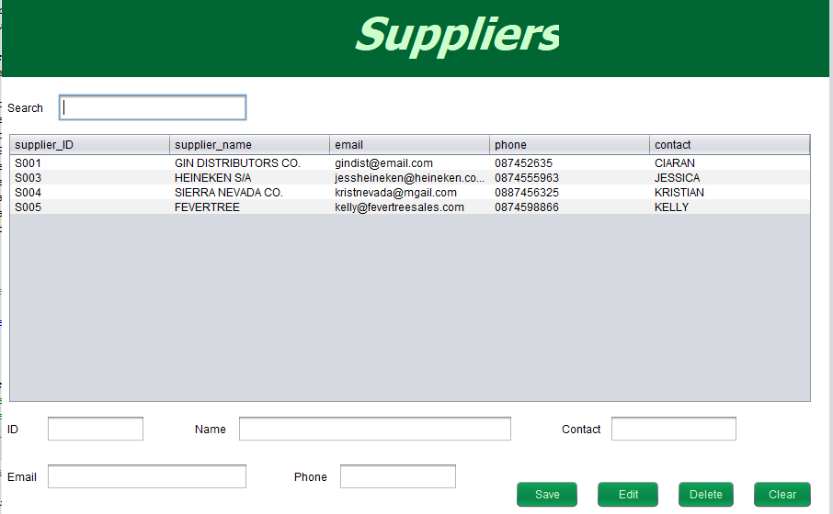
Stock Management System for Pubs

Slide 7
Stock Management System for Pubs
Advantages & Limitations
Describe the opportunities for the project and its future prospects.
How have you changed over the course of the project ?

